Slide 1

DNS
Hijacking
杨竣尧 郭荣锦 李晋一 林宇晟 谭演锋 梁卓文
Group 10

Slide 2

DNS Hijacking
Introduction
DNS &
IP Address
The Principle of DNS Hijacking
Categories of DNS Hijacking
How to Detect DNS Hijacking
How to Prevent DNS Hijacking

Slide 3
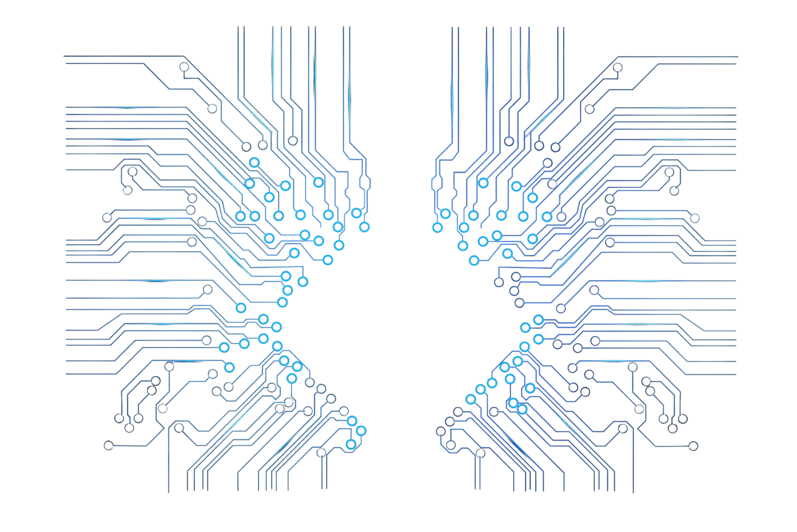

INTRODUCTION
杨竣尧 202130442068

Slide 4

DNS Hijacking
By attacking the domain name resolution server (DNS) or forging the domain name resolution server (DNS), the domain name of the target website is resolved to the wrong IP address, so that users cannot access the target website or maliciously require users to access the specified IP address (website).
attacking foraging

Slide 5
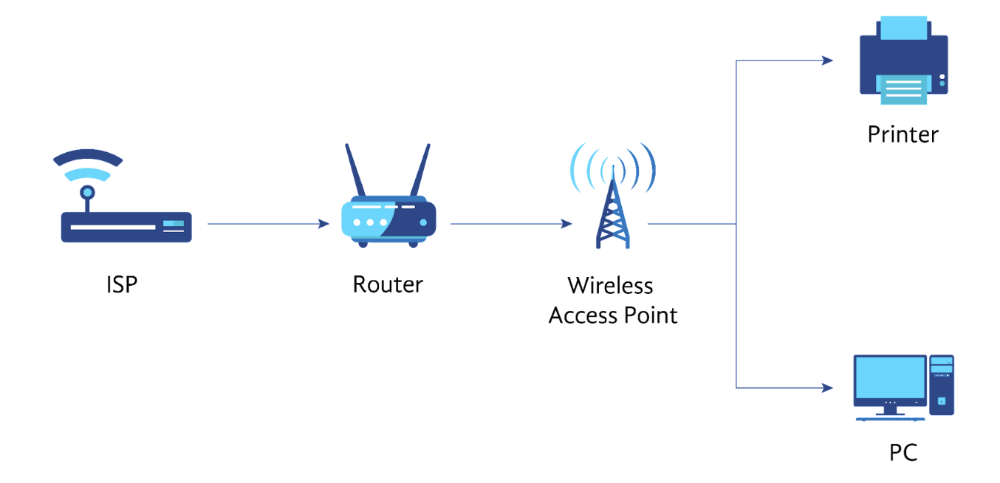
How DNS Hijacking works
Attack on DNS Service
Manipulation of DNS Records
Redirecting Traffic
Impact on Users

Slide 6
Intercept domain name resolution requests
Domain hijacking involves capturing domain name resolution requests within the compromised network's boundaries. It examines the requested domain name, permitting requests outside this scope while either returning a counterfeit IP address or causing the request to become unresponsive.
This results in the specific URL being inaccessible or leading to a counterfeit URL.

Slide 7
Affect the Internet experience of users
On the one hand, domain name hijacking may affect the Internet experience of users, users are led to fake websites and cannot browse the web normally, and the adverse impact of the domain name of the website with a large number of users will continue to expand after being hijacked;
On the other hand, users may be lured to fake websites to log in and other operations, resulting in disclosure of private data.

Slide 8

DNS vs IP
Where is google.com? Ah! It is at 66.102.13.105 : )
郭荣锦 202130134932

Slide 9

IP Address
DNS
IP addresses are made up of four groups of number with each group from 0 to 255 (IPV4).
(e.g IPV4 192.168.1.1
IPV6 provides a much larger address space than IPv4 )
DNS can be a string of characters
(e.g www.example.com
Easy to be remembered by users )

Slide 10

DNS provides the mapping of translating domain names into IP addresses. When a user enters a web address (e.g., www.example.com), the DNS server resolves this human-readable identifier into a machine-readable IP address (e.g., 192.0.2.1). This enables data to be correctly routed to its destination.
Mapping Relationship

Slide 11
In internet communication, DNS and IP addresses collaborate to ensure that user requests are delivered to the correct servers. DNS serves as a name resolution service, allowing users to access websites without the need to memorize complex numerical addresses, while IP addresses ensure data can be accurately routed within the network.
Collaboration

Slide 12
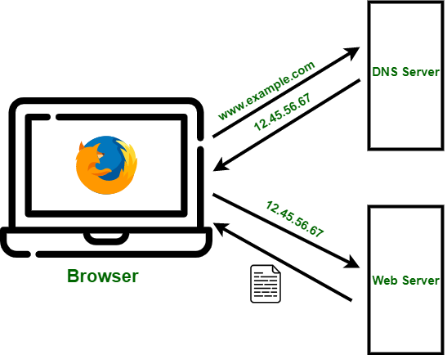
But how can the computer
translate a domain name into an IP address?
HOST FILES
RESOLUTION SERVER
It mainly uses hosts files which are store in the disk of the computer. However, the size of hosts files is limited, it cannot store every domain name in the world.
So, the solution is the domain name resolution server. When the domain name is entered by user, the domain name resolution server will translate the domain name into an IP address and send it back to the computer.

Slide 13


Difference
Purpose and Function
It is the unique identifier for devices in a network, allowing interconnection and communication between devices. It is akin to a telephone number in a telephone network.
It is a globally distributed service that translates user-friendly domain names into IP addresses. It's analogous to the mapping of names to telephone numbers in a phone directory.

Slide 14
Difference
Hierarchy
Belongs to the network layer and is a part of the Internet Protocol (IP), used for packet exchange and routing within the network.
Operates at the application layer and serves as a service for domain name resolution.

Slide 15
Difference
Variability
Can be either static (unchanging) or dynamic (subject to change). Dynamic IP addresses are often dynamically assigned by internet service providers.
Can be updated and modified as needed. For instance, when a website moves to a new server, its IP address may change, but the domain name remains the same, and DNS records are updated to reflect the new IP address.

Slide 16

The
Principle of
DNS
Hijacking
李晋一 202130430119

Slide 17
How is my DNS hijacked?
When you register a website with a domain registrar, you select an available domain name, and your site's IP address will be registered with the domain name.
A DNS record contains your site's unique IP address, and your domain name is linked to your site's IP address. In a DNS hijacking attack, hackers gain access to your DNS, then switch your unique IP address to another one. As a result, your domain name will point to the attacker's servers when retrieved via the DNS record.
In other words, when someone types the domain name into Chrome, Firefox, or another browser, they are not taken to your site. Instead, they are routed to a site the attacker controls. If the visitor thinks the site they are seeing is legitimate, they may mistakenly enter sensitive information or download malware.
Reference https://www.fortinet.com/resources/cyberglossary/dns-hijacking

Slide 18



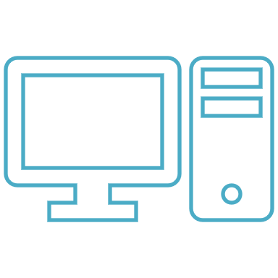

How is my DNS hijacked?
Domain name
IP Address

Slide 19

Why hijacking?
Cybercriminals use DNS attacks and hijacking tools to steal money from targets’ bank accounts, commit credit card fraud, sell personally identifiable information on the dark web, and take other malicious actions.
Hackers can use DNS hijacking to complement other cyberattack techniques, such as pharming (the display of unwanted ads to generate revenue) and phishing (enticing users to click on links to malicious websites to steal their data and credentials).
These types of cyberattacks can be significantly disruptive and can impact DNS traffic.
Reference https://www.eccouncil.org/cybersecurity-exchange/network-security/what-is-dns-hijacking-how-to-prevent-dns-attacks/

Slide 20

Categories of
DNS Hijacking
林宇晟 202130430140

Slide 21

l Local DNS hijack
— attackers install Trojan malware (特洛伊木马) on a user’s computer, and change the local DNS settings to redirect the user to malicious sites.

Slide 22
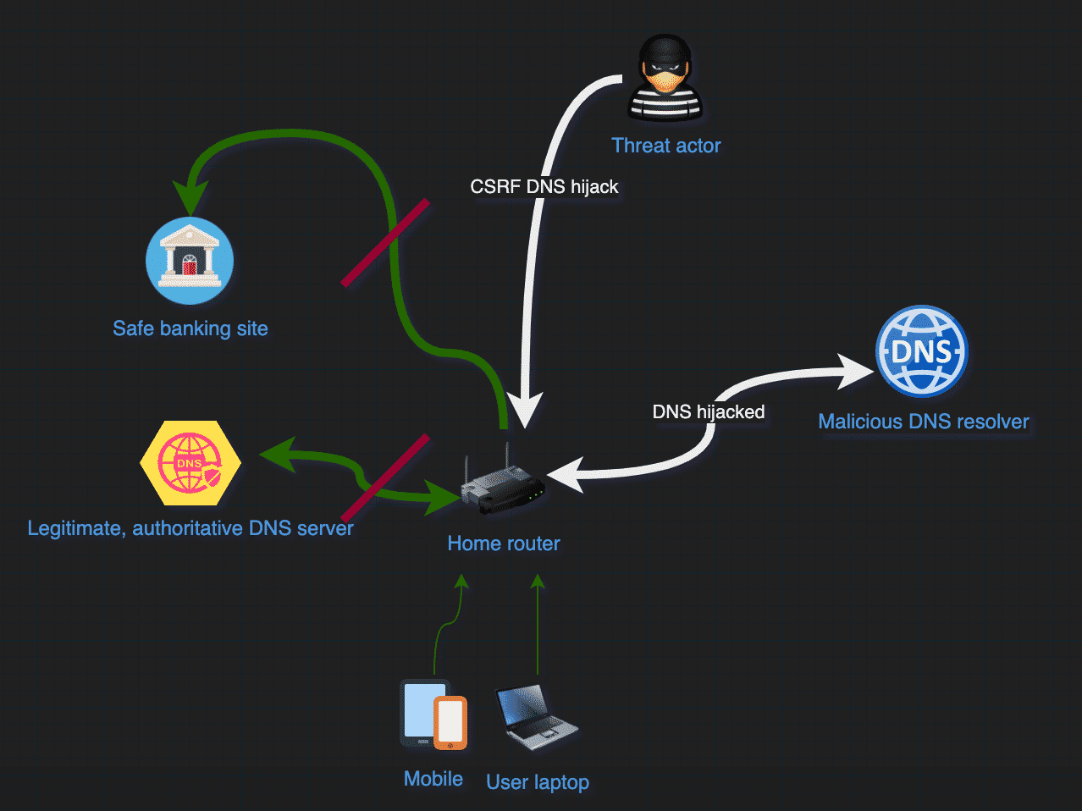
l Router DNS hijack
— many routers have default passwords or firmware vulnerabilities. Attackers can take over a router and overwrite DNS settings, affecting all users connected to that router.

Slide 23
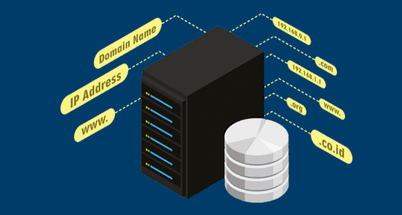
l Rogue DNS Server
— attackers can hack a DNS server, and change DNS records to redirect DNS requests to malicious sites.

Slide 24
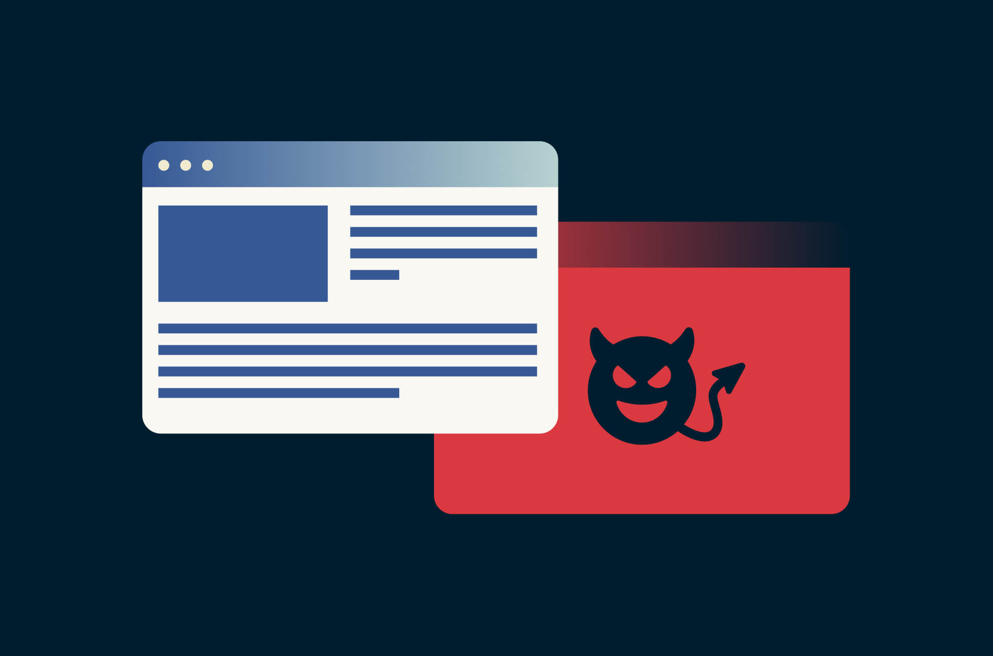
l Man-in-the-middle (MITM) DNS attacks
— attackers intercept communication between a user and a DNS server, and provide different destination IP addresses pointing to malicious sites.

Slide 25

How to Detect
DNS
Hijacking
谭演锋 202130100456

Slide 26
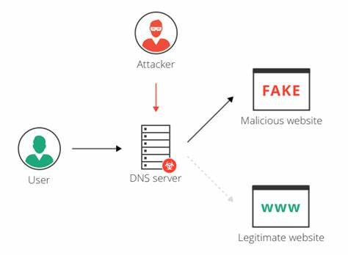
Signs of DNS hijacking
Common signs of DNS hijacking include web pages that load slowly, frequent pop-up advertisements on websites where there should not be any, and pop-ups informing the user that their machine is infected with malware. Fortunately, there are several internet tools you can use to check if your DNS has been hijacked.
GOOGLE SLIDE
CANVA
Click on the "Google Slides" button below this presentation preview.
Click on "Make a copy."
Start editing your presentation.
You need to sign in to your Google account.
Click on the "PowerPoint" button below this presentation preview.
Start editing your presentation.
Download and install the fonts used in this presentation as listed on the next page.
Click on the "Canva" button under this presentation preview.
Start editing your presentation.
You need to sign in to your Canva account.

Slide 27
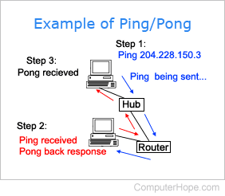
Pinging a network
You can identify DNS hijacking by using a ping program and pinging the questionable domain.
You will know your DNS has not been hijacked if the results show that the IP address does not exist.
On the other hand, if you ping the suspicious domain and an IP address comes up, there is a good chance that your DNS has been hijacked.
GOOGLE SLIDE
CANVA
Click on the "Canva" button under this presentation preview.
Start editing your presentation.
You need to sign in to your Canva account.

Slide 28
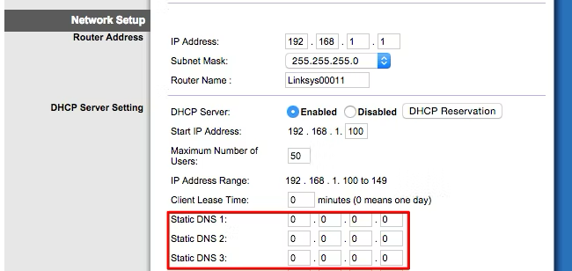
Checking your router
First, you'll need to access your router's web-based setup page. Check your network connection's gateway address or consult your router's documentation to find out how.
Then Look for a "DNS" setting somewhere, often in the WAN or Internet connection settings screen. If it's set to "Automatic," that's fine. If it's set to "Manual" and there are custom DNS servers entered there, that could very well be a problem.
It's no problem if you've configured your router to use good alternative DNS servers -- for example, 8.8.8.8 and 8.8.4.4 for Google DNS. But, if there are DNS servers there you don't recognize, that's a sign malware has changed your router to use DNS servers. If in doubt, perform a web search for the DNS server addresses and see whether they're legitimate or not. Something like "0.0.0.0" is fine and often just means the field is empty and the router is automatically getting a DNS server instead.
GOOGLE SLIDE
CANVA
Click on the "Canva" button under this presentation preview.
Start editing your presentation.
You need to sign in to your Canva account.

Slide 29
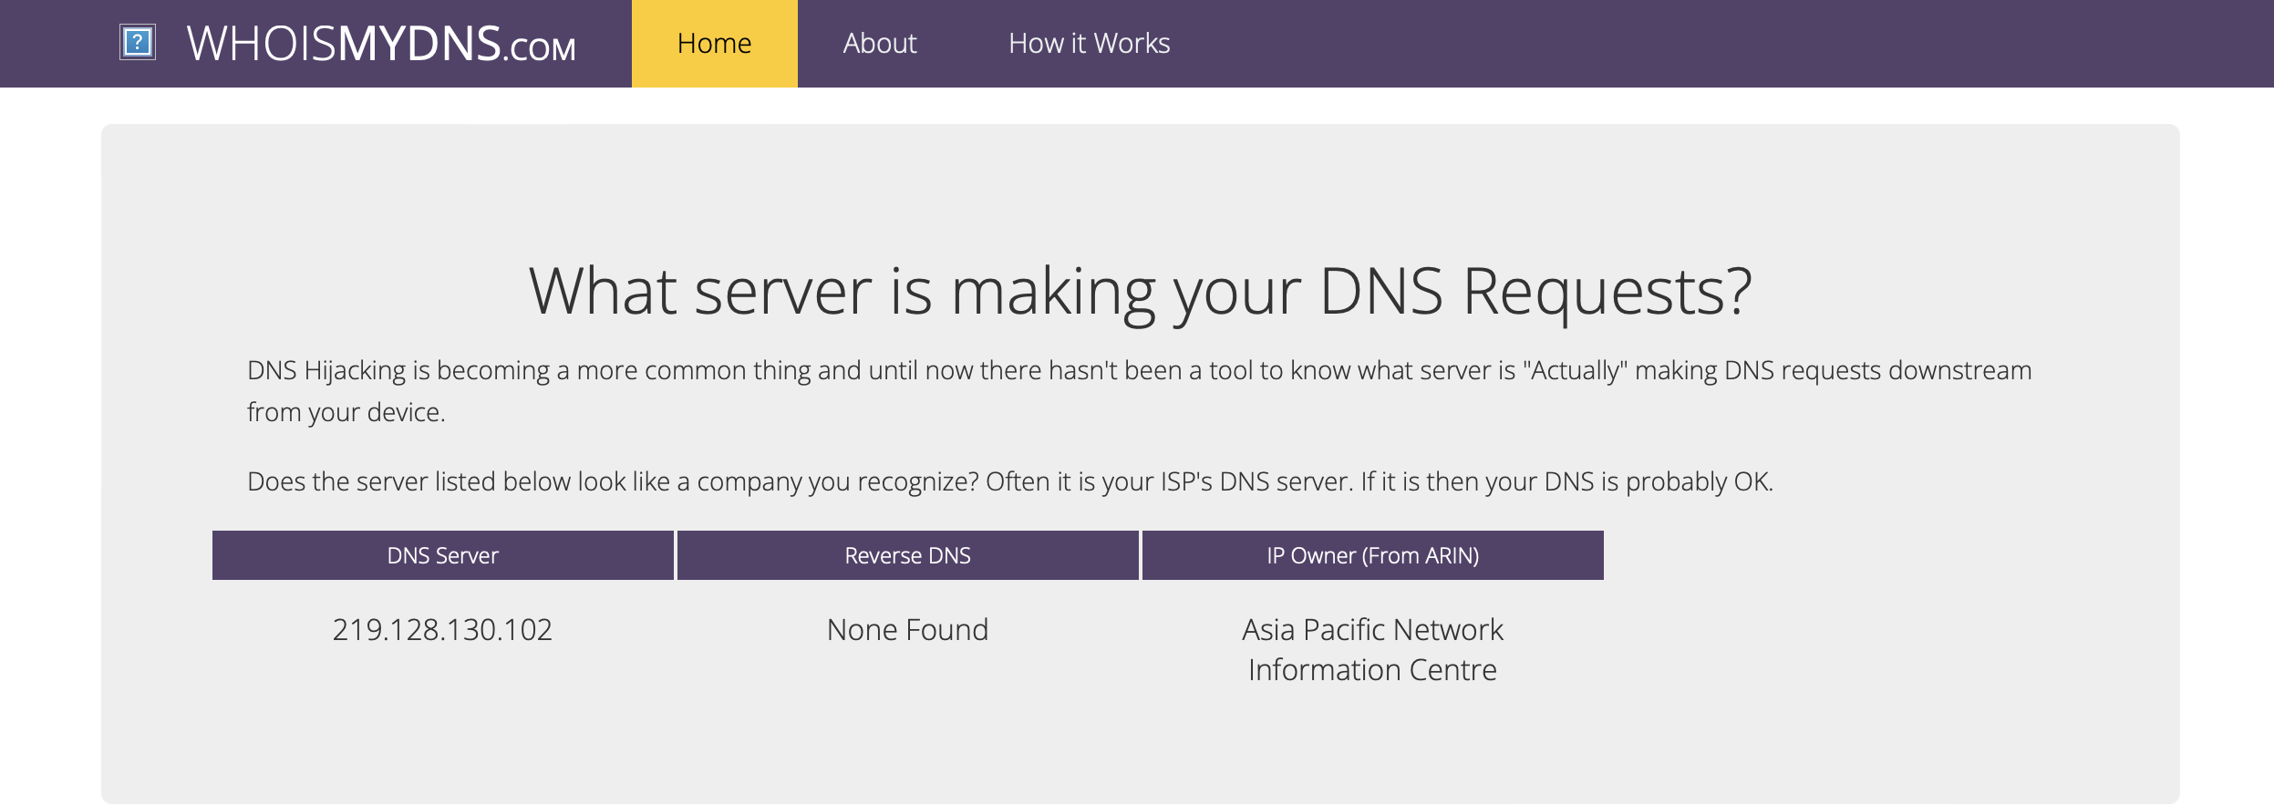
Check WhoIsMyDNS
An online tool is WhoIsMyDNS, which allows you to find the real server responding to DNS requests on your behalf. If the DNS displayed is unfamiliar to you, you may have fallen victim to DNS hijacking.
GOOGLE SLIDE
CANVA
Click on the "Canva" button under this presentation preview.
Start editing your presentation.
You need to sign in to your Canva account.

Slide 30

How to Prevent
DNS
Hijacking
Individual
Website owner
梁卓文 202130320915

Slide 31
HOW TO Prevent DNS Hijacking
Individual
Website owner
Do not click on suspicious links
Use Anti-malware
Use Registry Lock for Your Domain's Account
Using a Virtual Private Network (VPN)
Change your router's password (and username) regularly
Limit access to DNS
Enable client locking
Enable client locking

Slide 32
Never click on suspicious or unfamiliar links: this includes links in emails, text messages or social media.

Slide 33
2. Use Anti-malware
DNS hijackers can target users' login information using malware that reveals passwords. Installing antivirus software can help you catch any attacker trying to leverage this type of malware.
The best practice is to always scan your computer regularly for the presence of malware and update the software as prompted. The system's security software will help you find and remove any infections caused by DNS hijacking, especially in case of Trojan malware infection during local hijacking.

Slide 34

Use Registry Lock for Your Domain's Account
When you enable Registry Lock, the domain is locked at registry-level. This means that no changes can be made by unauthorized people to:
Name servers
Registrant's name, address, or contact details
Changes of registrar
For some top-level domains
This can stop hackers from redirecting people to malicious sites after they type in a domain name.

Slide 35

Using a VPN
A VPN provides an encrypted digital tunnel for all your website queries and traffic. Most well-known VPN use dedicated DNS servers that specialize in protecting your local computer and their DNS servers with end-to-end encryption requests. As a result, requests received by the server cannot be interrupted, radically reducing the possibility of man-in-the-middle DNS hijacking.

Slide 36
vulnerability in router hijacking
When creating a new password, we always recommend a "strong" password (about 10-12 characters long, with a mix of special characters, numbers, upper and lower case letters). Also, update your router password regularly
Change Router’s Password

Slide 37
For website owner

Slide 38
Limit access to DNS Settings to a few members of a dedicated IT team, thereby limiting potential opportunistic cybercriminals from taking advantage of your team members.
Some DNS registrars support "client locking," which prevents any changes to DNS records from being made without approval. We recommend enabling this feature whenever possible.
The Domain Name System Security Extension is a kind of "verified true" label that helps keep DNS queries authentic. As a result, it is more difficult for hackers to intercept requests from your DNS.
Limit access to DNS
Enable client locking
DNSSEC

Slide 39
Q&A
How many different types of DNS hijacking？And what are they?
Local DNS hijacking
DNS hijacking using a router
Man-in-the-middle (MITM) attacks
Rogue DNS server attacks

Slide 40
Reference
1. Antonakakis, M., Perdisci, R., Dagon, D., Lee, W., & Feamster, N. (2010). Detecting Traffic Redirection in the Internet with Argos. Proceedings of the 2010 ACM SIGCOMM Conference on Internet Measurement Conference, 212-225. DOI: 10.1145/1879141.1879169
2. Bursztein, E., Bethencourt, J., & Boneh, D. (2014). The Security of HTTPS and DNSSEC: A Systematic Analysis. Proceedings of the 23rd USENIX Conference on Security Symposium, 775-790.
3. Wang, H., Zhang, Y., Li, Z., & Wu, J. (2017). Detecting and Characterizing DNS Hijacking Based on Active DNS Measurements. IEEE Transactions on Information Forensics and Security, 12(8), 1823-1838. DOI: 10.1109/TIFS.2017.2682541
4. Liu, Y., Li, Z., Hu, J., & Chen, Z. (2019). A Survey on DNS Hijacking Attacks and Defense Mechanisms. Security and Communication Networks, 2019. DOI: 10.1155/2019/3094347
5. https://www.fortinet.com/resources/cyberglossary/dns-hijacking
6. https://www.eccouncil.org/cybersecurity-exchange/network-security/what-is-dns-hijacking-how-to-prevent-dns-attacks/

Slide 41
THANK YOU!

